Slide 1


PUOKHU VATSHA 9.6 BVU
KETHOLESHIIDA… DIETHERIEKO
Ketholeshiida … Dietherieko kezhakesu, Kijiipete Krothoko Fort Worth, Texas
©2006 TBBMI
Designed by Dr. John Fryman, Texas, USA • BibleBasically.org
Taught by Dr. Rick Griffith, Singapore Bible College
All files in many languages for free download at BibleStudyDownloads.org
www.biblebasically.com
©2006 TBBMI

Slide 2
NPezieri Kepfenyii Suchie… KEPETHA BA CHU KI , MHAKEBOU KECHU VIENGAKO SEHIECIE.
SIRO NZEMIAKO NPEZEITUO
01
1
9.6.01.

Slide 3
©
Ketholeshuda… Dietheriko Kijupete La Krothoko
Krotho Kekhrohiko
Dr. John Hannah
Terhukepfü Professor Historical Theology Kpetha-o
Research Professor, Historical Theology
Dallas Theological Seminary
Dallas, Texas
Dr. Rick Griffith
Bible dze Kepetha-o
NT Department Coordinator
Singapore Bible College
Singapore, Republic of Singapore
Dr. Mark Bailey
Kedaghe
Dallas Theological Seminary
Dallas, Texas
John Maisel Kurt Nelson
Kedaghe Exec. Ato Kedaghe
East/West Ministries
Dallas, Texas
Dr. William R. Bright
Thiedzu Pesiekeshuko
Campus Crusade for Christ
Orlando, Florida
Vasily Dimitrievski
Director for Russia
Global Missions Fellowship (e3)
Penza, Russia
Rev. Douglas Valenzuela
Pastor Phicu, Conservative Baptist Missions
Chiesa Battista Evangelica di Casoria
Naples, Italy
Dr. Ted Kitchens
Pastor Phicu
Christ Chapel Bible Church
Ft. Worth, Texas
Karyn Granger
Director of Bible Studies
Southwest Christian Schools
Ft. Worth, Texas
Dr. Kenneth Horton
Pastor Phicu
McKinney Memorial Bible Church
Ft. Worth, Texas
9.6.01.
©2006 TBBMI
02

Slide 4


Bible Nu Thechu Merhi Khapie Bayakezhako
Uko krothoko Todd Boln puophouliete, kekrilamonyu Ketholeshuda nu Thichu Miarhi khapie Bayakezhako puo noumvu di uko bu Ketholeshuda Diethierieko Sebakechula. Ketholeshuda Diehierieko sekebako vodi BiblePlaces.com meho mu miarhiko pfuliechie, kekrilamonyu Ketholeshuda thenyie kezu hanu ba: Kemasa thechu vo Agean mu Medterranean thela ketso nunu vo pesotsa Europe ketso, kerapuo kepeliamia kepele mia kepele sedeklie thechu nu. BiblePlaces.com nu kepetha mu miarhi vithor kechu mu mejuliekengukechu ngulietuo.
Vodi mehoshuchie!
Npezie, Todd!

Slide 5
Ketholeshuda…Diethirieko Mhatho sedelie, chukelie, mu pesiekelie hau Eno John E. Fryman, Ph.D. pesieshu.
Copyright © 2006 The Bible…Basically Ministries Intl. Inc., Ft. Worth, Texas
Mhapete hau nu Thezho nu vakhabate. Mhatho hau United States of America thezho khronu chupieba . Thedzu thukeshuko ketso sanyu modi miapouribu thiedze mouri thiedzei opouri seliekenju. Derie no mhacapouri thukeshu nunu senytaro vo thedze thueshuko ze kepfusi levi.
Leshuda hau nu hom leshukephriemibu seliekevi kropou khapkrieba.
Krotho hau Dr. Todd Bolen, Master’s leshuki Kepetha-o, Jerusalem, Israel, mu Ketholeshuda Nu Thechu Merhi Khapie Bayakezhako (BiblePlaces.com) puophouliete kekrilamonyu mhari kedi puo semorosou bashi uko bu hau pesulie ketuola selienuya. Kadesh-Barnea miarhi hau liro Dr. Leen Ritmeyer, Hawthornedene, Australia ki ketsoliedi sebate. Themia kehoupuori thezho chupie keba kemhie hieko ketso modi leshuda sebataro kepfesilie nuya. Siliro puotuo di mhachako kepfesilietatou. Thiezo nu sehie nu chuko hiekorie leshu mu merhi seimo.
Kepethako, thedze seyakezhako mu kekhrohi kebako vo miarhi, ko, khonou miarik mouri mhakehoupouri chutouri vodi, ndie nu mouri computer miariko kesyakeba koselielho,, tsiedo mhanga keviko bie kedi lekengu, pesiekeshuko ki ketso modi selielho.
United States of America peseishu mhatho. Kiju pete thezho nu vakhapie ba.
©2006 TBBMI
9.6.01. 03

Slide 6
KETHOLESHUDA …
DIETHERIEKO
Ketholeshuda … Dietherieko kezhakesu, Kijupete La Krothoko Fort Worth, Texas
www.biblebasically.org
9.6.01.
©2006 TBBMI
04
Notes:
PLEASE PUT THE TITLE AND SUBTITLES INTO YOUR NATIONAL LANGUAGE AND LEAVE THE WEBSITE UNCHANGED

Slide 7


(Kedi puolaga: Bible si mu semenuo ketuola!)
KETHOLESHUDA… DIETHERIEKO
®
SEDE KO
“KETHOLESHU DA”
ZA PUO
05
©2006 TBBMI
9.6.01.

Slide 8
KEDIPUO KEMHIEDI HAKO NGULIE …
Khristanmiako Bode
Uko Mhatho Hau La Keze Mhalie Pesoushu Chie!
?
Khristamiako Kepele Zhoko
Ketholeshuda Pemvu di Leshuda peteko:
Siminary Leshuda Baya Kezha nu Pete Ko:
Mechu Leshuda Baya Kezha nu Pete Ko
Miali Leshuda Baya Kezha nu Pete Ko
University Leshuda Baya Kezha nu Pete Ko
Kiju nu seyie Pete ko
Die kekri Kecu Pete Ko
Mu
Ketholeshuda Pemvu Di Mhalie Kebako
Kiju Pete Nu Kepelemiako Mu Pelekemoko
06
15
©2006 TBBMI
9.6.01.

Slide 9

U Kepele Dietherieko Thupie Kebako
Leshuda puolha. 6
2
07

Slide 10

Puo Leshuda Nu “Ketholeshuda hau pete kedipuo ga!”
Dr. Henrietta Mears thushu…
Leshuda puolha. 6
08

Slide 11
Themai kekra Ketholeshuda mhasi: Ketsie puomakere puorhu kemhie
Derie keprumai kekra mhalie…
Leshuda puolha. 6
09

Slide 12
Leshuda puolha. 6
11

Slide 13

…ketsie puorhu shu tete… Ketholeshuda nousuo nuyie dzeko mharu mu mhachu kehieliewe. Derie hau nu mharhu menuo modi kepfuta!
Leshuda puolha. 6
10

Slide 14
Ketholeshuda Kemeshu
Puoca Puola Kesouko
Kemesa Ruopfu Chatha PfuPesou Keshu
12
2

Slide 15
?
?
?
Kepenuopfu Urhakelie Dze
Abraham Mu Thiedzu Israelko
Jesu Khrista Upekie Keshu
Kehouki Penuo Kelie
?
?
?
?
?
?
13
5

Slide 16





  Ketholeshuda Hau Pete Meho Su Chie!
14

Slide 17
kebvu kebou kechu haula sierta!
HAU MHAKEBOU KEBVU PEZHASE!
• Nyiepuo kezie thu pedekeshuko
• Kriepuo Zhoruli
• Die Lakh Thenie di Nyiehepengou
• Thuthe Nyiepuo di Kriekenie
• Kesokhu Nyieserpuo
• Puphralekelho Thushu mu
Vatsha Piezhu
15
7

Slide 18
SUPUO HAU PUSHU?
SUPUO HAU CHUGA?
LESHUDAKO
KEDIPUOLA?
THEMIAKO
TEISOZHAKO
SUPUO MU KEDIPUO ZE KEMHIEGA?
16
7

Slide 19
KEKHROUHI SUCHIE!
KEKHROUHI SUCHIE!
SUPUO HAU PUSHU?
SUPUO HAU CHUGA?
LESHUDAKO
KEDIPUOLA?
THEMIAKO
TEISOZHA
SUPUO MU KEDIPUO ZE KEMHIEGA?
17

Slide 20
KEKHROUHI SUCIE!
A PUSALIE KENJU TE!!!
SHULA...A PASTOR
BU HAKO
CHUSHU TUO!
18

Slide 21
SUPUO NLA PUO
NOUNYU YAGA?
19

Slide 22
SULA KEDIPUO GA?
20

Slide 23
“Kepele kethou nu sede le kemochie, Kenoudo, Themouko mu Mhale Mha kechu, hako kemhie kekrei mo ”
Miles Stanford
Ruopfu-u Memhie Kezhu Thezhou
kethou
Kenoudo
Themouko
Mhale Mha kechu
21
4

Slide 24
Leshukephru bo Cho-u…
“Hieko sikeba mho pelielelho,
Mu hieko pele keba mho lhoulelho.”
Albert Mohler, Kedahge
Southern Baptist Seminary Leshuki Louisville, KY
22
3

Slide 25
Sie…
ha nunu tuo shu tuo!
(Mu Kehou tei nu bamota hie cie. Yopuo-e kekrie-u ze kekhe ba kechu la!)
KETHOLESHUDA…
DIETHERIEKO
KETHOLESHUDA…
DIETHERIEKO
9.6.01 . 23
1
©2006 TBBMI
9.6.01 . 23
1
©2006 TBBMI
23
©2006 TBBMI
9.6.01.

Slide 26
KETHOLESHUDA…
DIETHERIEKO
®
Hau ukelhou zho!
24
Notes:
CHANGED FROM THE ORIGINALS (TQC)

Slide 27
KETHOLESHUDA... DIETHERIEKO
®
No Ketholeshuda silie mu mhale menuo
LIE tatuo!
25
Notes:
CHANGED FROM THE ORIGINALS (TQC)

Slide 28
KETHOLESHUDA…
DIETHERIEKO
®
LESHUDA NU KEMEYIEKO : Hanuha NO miapetha lekevi mhapuoba!
P 7 K J
Zhapu hau kemhiedi sede pevilie shi!!!
26
1
Notes:
CHANGED FROM THE ORIGINALS (TQC)

Slide 29
Ketholeshuda…
Dietherieko
®
Sede Ko
“N Ketholeshu Da”
27
Notes:
CHANGED FROM THE ORIGINALS (TQC)

Slide 30
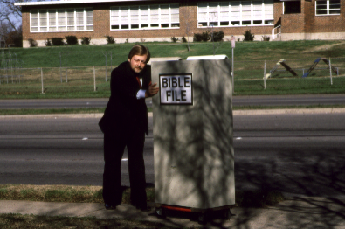
28

Slide 31
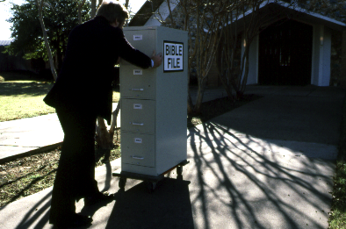
29

Slide 32
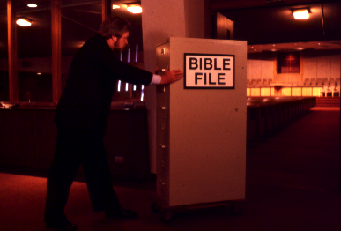
30

Slide 33
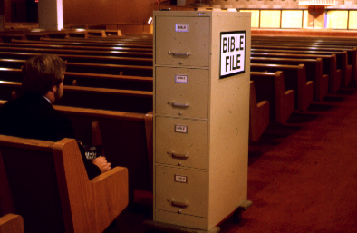
31

Slide 34
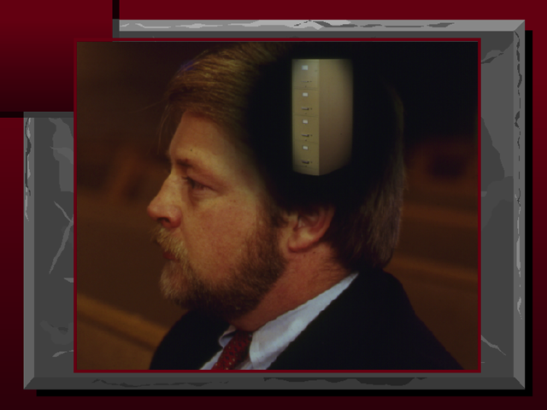
32

Slide 35
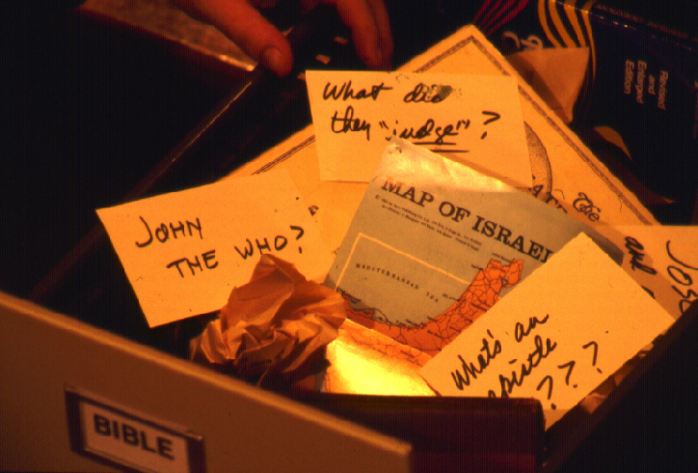
?
SIRO… NO KEDIPUO KEMHIEDI PESIKESHU KO… MU PESITUOLIE MOKETAKO CHUVOKETUOKO SEDETA?
?
?
?
33
5

Slide 36
A thedo mhapouri ba MO te!
Kedipuo kemhie di sede tuo ga?
34

Slide 37
7
Leshuda puolha 8-14
35

Slide 38
7
7
Leshuda puolha 8-14
1
36

Slide 39
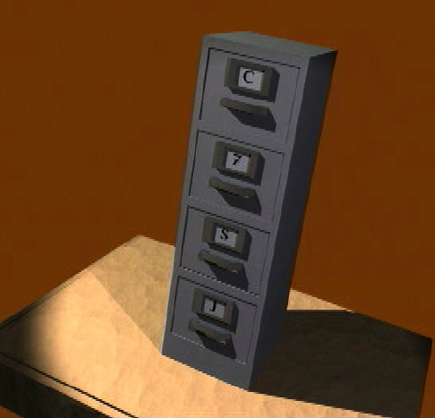
7
N KETHOLESHU DA
Leshuda puolha 8-14
37

Slide 40
7
N KETHOLESHU DA
MIARHI HAU LESHU HANU BA , DERIE TSIE PEKIELIE SUOTE
Leshuda puolha.. 8-14
38

Slide 41
7
1
2
3
4
5
6
7
8
9
10
Leshuda puolha. 8-14
39

Slide 42
7
Sede Ko
“N Ketholeshu Da”
7
7
7
7
7
7
7
P
7
K
J
P
J
P
K
J
P
K
J
K
Leshuda puolha 8-14
4
40

Slide 43
Sede Ko
“N Ketholeshu Da”
7
7
= 4+3
Leshuda puolha. 8-14
2
41

Slide 44
7
Sede Ko
“N Ketholeshu Da”
P 4 3 K J
P 4 3 K J
Leshuda puolha 8-14
1
42

Slide 45
Mhaca Kemeyie 5:
7
P = PELHOUKESHU
4 = THEMIAKO
3 = KROTHOKO
Z = ZIKETA
J = JESU
Leshuda puolha 8-14
5
43

Slide 46
Mhaca Kemeyie 5:
7
P = PELHOUKESHU
4 = THEMIAKO
3 = KROTHOKO
z = ZIKETA
J = JESU
Leshuda puolha 8-14
6
44

Slide 47
Mhaca Kemeyie 5:
7
P = PELHOUKESHU
4 = THEMIAKO
3 = KROTHOKO
Z = ZIKETA
J = JESU
Leshuda puolha 8-14
45

Slide 48
THEMIA 4 KO LIRO:
7
A BRAHAM
J OSEF
M OSA
J OSHUA
Leshuda puolha. 8-14
5
46

Slide 49
7
A
JASHU
MU
JASASHU!
Leshuda puolha 8-14
47

Slide 50
Themia 4 ko:
7
J OSEF
A BRAHAM
A
M OSA
JASHU
J OSHUA
MU
JASASHU
Leshuda puolha 8-14
8
48

Slide 51
7
PELHOUKESHU
ABRAHAM
JOSEF
MOSA
JOSHUA
Leshuda puolha 8-14
5
49

Slide 52
Mhaca Kemeyie 5 :
7
P = PELHOUKESHU
4 = Themiako
3 = KROTHOKO
Z = ZIKETA
J = JESU
Leshuda puolha 8-14
50

Slide 54
KROTHO 3 KO LIRO:
7
U LA KRIKO
K EDIMIAKO
M IADIA KECHU
Leshuda puolha 8-14
6
52

Slide 55
PELHOUKESHU
ABRAHAM
JOSEF
MOSA
JOSHUA
ULAKRIKO
KEDIMIAKO
MIADIA KECHU
7
Leshuda puolha 8-14
53

Slide 56
7
7
MEHOLA KESHU...
P 7 K J
P 4 3 K J
Leshuda puolha 8-14
3
54

Slide 57
PELHOUKESHU
THEMIA 4 KO
KROTHO 3 KO ZIKETA
JESU
7
Leshuda puolha 8-14
55

Slide 58
7
PELHOUKESHU
ABRAHAM
JOSEF
MOSA
JOSHUA
ULAKRIKO
KEDIMIAKO
MIADIA KECHU
ZIKETA
JESU
Leshuda puolha 8-14
2
56

Slide 59
N Mhalie Kesi “Ketholeshu Da”
PELHOUKESHU
PELHOUKESHU
ABRAHAM
ABRAHAM
ABRAHAM
ABRAHAM
JOSEF
ABRAHAM
MOSA
JOSEF
JOSHUA
ULAKRIKO
MOSA
KEDIMIAKO
MEADI KECHU
JOSHUA
ZIKETA
JESU
ULAKRIKO
KEDIMIAKO
MIADIA KECHU
ZIKETA
JESU
Leshuda puolha 8-14
57
11

Slide 60
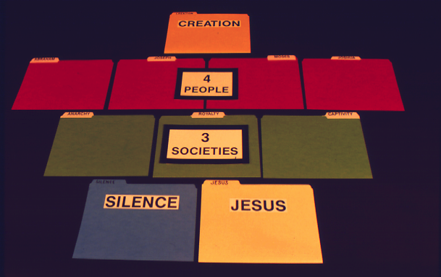
7
PELHOUKESHU
Leshuda puolha 8-14
58

Slide 61
7
PELHOUKESHU
THEMIA
4 KO
Leshuda puolha 8-14
59

Slide 62
7
PELHOUKESHU
THEMIA
4 KO
KROTHO
3 KO
Leshuda puolha 8-14
60

Slide 63
7
PELHOUIKESHU
THEMIA
4 KO
KROTHO
3 KO
ZIKETA
JESU
Leshuda puolha 8-14
61

Slide 64

7
KIJU KETHODI RUDI SI TE!
Leshuda puolha 8-14
62

Slide 65
7
PELHOUKESHU
CREATION
ABRAHAM
ABRAHAM
ABRAHAM
ABRAHAM
ABRAHAM
ABRAHAM
JOSEF
JOSEPH
ABRAHAM
ABRAHAM
MOSA
MOSES
JOSHUA
JOSHUA
ULAKRIKO
ANARCHY
KEDIMIAKO
ROYALTY
MEDIA KECHU
CAPTIVITY
ZIKETA
SILENCE
JESU
JESUS
63

Slide 66

KETHOLESHU DA
64

Slide 67

C
PELHOKESHU
ULAKRIKO
ZIKETA
JOSEF
KEDIMIAKO
MOSA
MIADIA KECHU
65
10

Slide 68
P 7 K J
C
{
}
PELHOKESHU
ULAKRIKO
ZIKETA
THEMIA
4 KO
KHROTHO
3 KO
KEDIMIAKO
MOSA
MIADIA KECHU
66

Slide 69
N MHALIE KETHOLESHUDA!
PELHOUKESHU
ABRAHAM
JOSEF
METEI SECHU
MOSA
JOSHUA
ULAKRIKO
KEDIMIAKO
MEYA SECHU
MIADIA KECHU
ZIKETA
JESU
PECU SECHU
67
4

Slide 70

Tsie Ketholeshuda… Dietherieko nkele nu bate …
•Ndo Hau Liro “Ketholeshu Da”
•N Mhale Nu Khrushuketou Cabi “Ketholeshu Da”…P7KJ
1. KEDIPUO MHIETA!
MHACA SE KELASHU KETUO
2. KIUDI HAKEMHIETA!
3. KETHOLESHU RHIKO MU THUPIEKEBAKO HIEKEWA
68
4

Slide 71
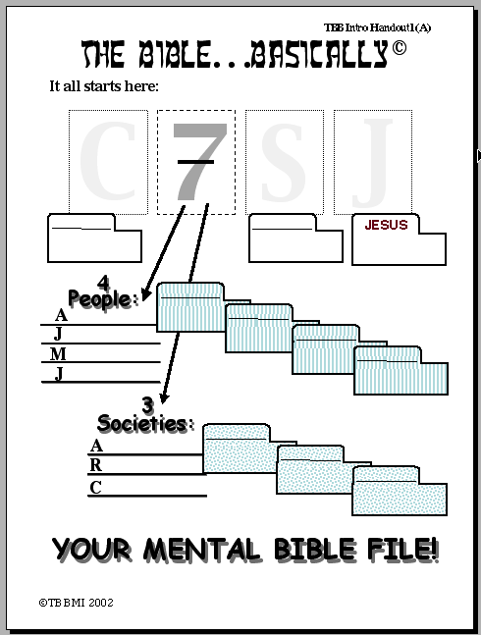
KETHOLESUDA… DIETHERIEKO
Hanu sede tuo:
P
7
K
J
ZIKETA
PELHOUKESHU
{
Themia 4 Ko
ABRAHAM
BRAHAM
JOSEF
OSEF
MOSA
OSA
JOSHUA
OSHUA
{
KEPHRU KEKROHI #01
Krothoko
ULAKRIKO
ULAKRIKO
KEDIMIAKO
KEDIMIAKO
MEDIA KECHU
MEDIA KECHU
N MHALIE KETHOLESHU DA!
©2006 TBBMI
69
20
9.6.01.

Slide 72
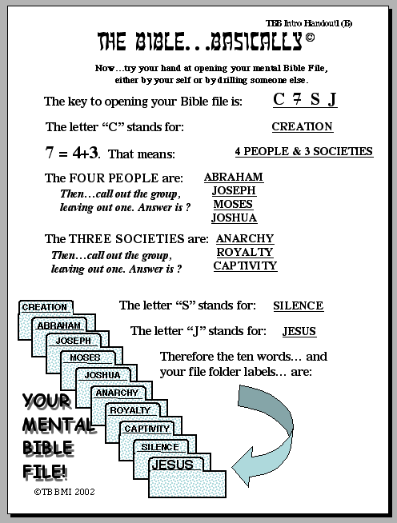
KETHOLESUDA… DIETHERIEKO
Ketholeshuda Khrushuketou Cabi liro
P 7 K J
‘P’
PUOKHOU “P” CHA LIRO:
PELHOUKESHU
LIRO
THEMIA 4 KO MU KROTHO 3 KO
THEMIA DE KO:
JOSEF
MOSA
ULAKRIKO
KEDIMIAKO
MIADIA KECHU
KEPHRU KEKROHI #02
KROTHO SE KO:
Z
PUOKHOU “P” CHA LIRO:
ZIKETA
PUOKHOU “J” CHA LIRO:
...
Sula cha keru… mu n leshu lha ko… liro
N MHALIE
KETHOLESHU
DA
©2006 TBBMI
9.6.01.
9
70

Slide 73
7
71

Slide 74
KETHOLESHU… DIETHERIEKO
KRUSHUKETUO CABI LIRO
“N KETHOLESHU DA”
72

Slide 75
No tsie puokelhe ko siliete… Sula tsie hau nu votazhie …
•Ndo Hau Liro “Ketholeshu Da”
•N Mhale Nu Khrshuketuo Cabi “Ketholeshuda”…P 7 K J
•Kele Miarhi Nu Ketholeshuda Nu Mhatho Kemeyie Voketako Pfukechu.
•Ketholeshu “DZE” Kesouko: “Nuose Nuoyie Mhaketa”
•Abraham Mvudzeko Ketholeshu Nunu Sede Di Mezhu Vo Niepu Jisu Khrista Mhatho Ketso
• “Thedze” Pemvudi Ketholeshu Chukeshuko
•Ketholeshu Kewe-u Mu Kesa-u Leshuda Mu Cauko
 
8
73

Slide 76
KETHOLESHUDA… DIETHERIEKO
Ketholeshuda … Dietherieko kezhakesu, Kijupete Krothoko Fort Worth, Texas
www.biblebasically.org
9.6.01.
©2006 TBBMI
74
Notes:
PLEASE PUT THE TITLE AND SUBTITLES INTO YOUR NATIONAL LANGUAGE AND LEAVE THE WEBSITE UNCHANGED

Slide 77


Ketholeshiida…Dietherieko • BibleStudyDownloads.org
Get this presentation for free!
Notes:
The Bible…Basically (bb)

Slide 78
75
©2006 TBBMI
9.6.01.

